Slide 1
Professional Emails
College Prep
Mr. Gordon
jgordon@bisdtx.org

Slide 2
Upcoming Events
hi

Slide 3
Professional Emails
When emailing an ACC professor, you need to use your ACC email. Professors will not open your email from your BISD account.
Any time you email a professor or teacher, it needs to be
professional and proofread. If you need help, always ask a friend or Mr. Gordon to look over it before pressing send.
Remember to include all the information, so that they can answer the question. Always check your syllabus before emailing to make sure the information is not in there.
hi

Slide 4
Professional Emails
Check your email signature as well. Is that professional?
Even if you are frustrated with a professor or feel like they were not fair, it is always important to be polite and professional.
Never be rude.
You will be far more successful with your request by being polite.
hi

Slide 5
Personal Emails
To complete job resumes and college applications, you will need a personal email if you do not already have one.
Check to make sure it is professional sounding and not an embarrassing email you created in middle school.
A good example could be john.doe@icloud.com
hi

Slide 6
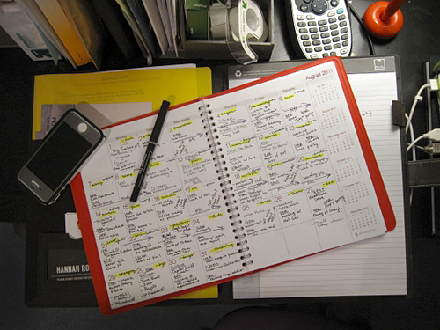
Assignment
In the comment’s section, answer the following question:
Will an ACC professor read an email from your BISD account?
Yes or No
hi

